Slide 1
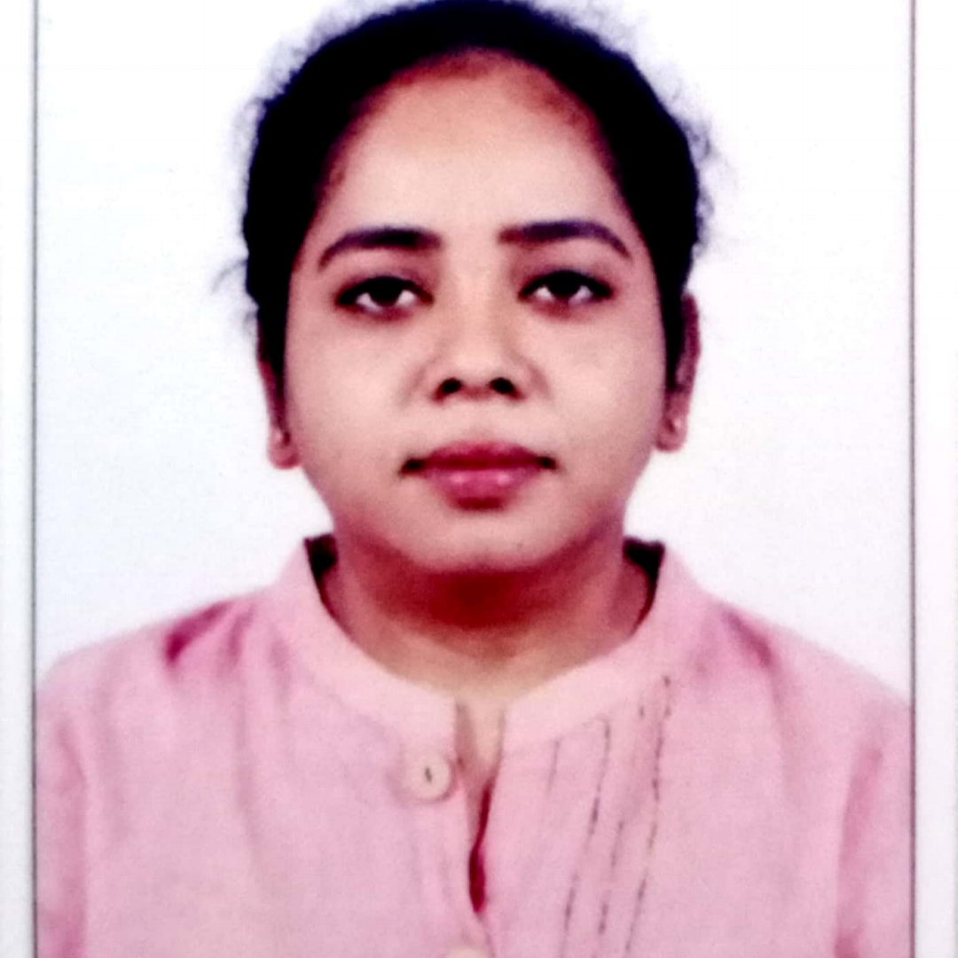
POOJA K.V
Analyst/Software Engineer
Bachelor of Engineering, Civil Engineering:2017 - 21
Skills
Bangalore
Java | Java Basics, OOPS, Generics, Collections, Arrays, Loops.
Angular | Components, Services, Modules, Routing, Forms & Validation.
UI | Angular, html, javascript, typescript , css Bootstrap.
Database | PostgreSQL
Tools | Git, Postman, Swagger, Visual Studio Code
Add On skills | Peer learning
POOJA.A.K-V@CAPGEMINI.COM
+91 8296242852
A4
Full Stack Developer trained on JEE full stack with Angular
Hands on experience on
Core Java
J2EE
SQL
Hibernate and Spring Frameworks
HTML, CSS , JavaScript , Typescript and Angular
Git and GitHub
FINAL CASE STUDY:
Created an InterviewTracking System With PostgreSQL
Backend and .Java Web and Angular as Frontend Used HTML, CSS ,Bootstrap and TypeScript for the UI designing.

